Slide 1
Introduction to MATLAB/Simulink
By
Pi Thanacha Choopojcharoen

Slide 2

Content (MATLAB)
MATLAB GUI
Scalar
Vector
Matrix
Commonly-used Builtin Functions
Filesystem and Path
Visualization

Slide 3

Content (Simulink)
Signal Synthesis & Monitoring (Sink & Source)
Commonly-used Blocks in Simulink
Multi-channel Signal
Integrator
Simulation Time
Exporting Results to MATLAB Workspace
Modelling Vector Equations
Subsystem, Mask Editor
GUI in Simulink
Event-driven Simulation

Slide 5
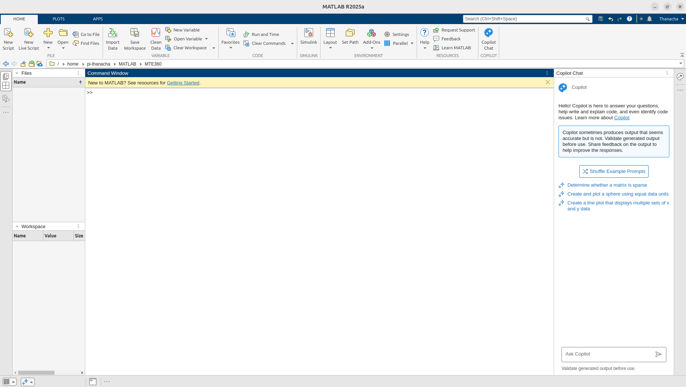
MATLAB GUI (2025a)
Working Directory
Files in the directory
Command Window
Workspace
Copilot

Slide 6
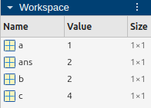
Scalar: Variables
>> 1+1
ans =
2
>> a=1 % command without semicolon will print the output if there is any
a =
1
>> b=ans; % command with will not automatically print the output
>> c=a+b;
>> c=c+1;

Slide 7
Scalar: Pre-defined Constants
>> i
ans =
0.0000 + 1.0000i
>> j
ans =
0.0000 + 1.0000i
>> pi
ans =
3.1416
>> eps % floating-point relative accuracy
ans =
2.2204e-16
>> realmax % Largest Floating-point number
ans =
1.7977e+308
>> realmin
ans =
2.2251e-308
These variables can be overridden.
Simply call clear [variable] to return the variable to its original value, i.e. ”clear pi”

Slide 8
Scalar: Built-in Arithmetic Operations
>> a = 1+2-3*(4/5^6)
a =
2.9992
>> b = sin(pi/2)+cos(pi)+exp(a)-log(exp(1))+log10(10)-log2(2)
b =
19.0701
>> c = 1/0 % infinity
c =
Inf
>> d = 0/0 % not-a-number
d =
NaN
MATLAB will not throw an error when infinity or NaN occur. It’s your job to take care of your computation properly.

Slide 9
Scalar: Some Numerical Error
>> cos(pi/2) % numerical approximation of pi is used
ans =
6.1232e-17
>> cos(sym(pi)/2) % another cosine function that operates on symbolic variable
ans =
0
If you are deriving symbolic expressions, you should use the corresponding symbolic constant instead of its pre-defined numerical approximation.

Slide 10
Scalar: Boolean
>> true
ans =
logical
1
>> false
ans =
logical
0
>> a = 3<1
a =
logical
0
>> b = pi<=3
b =
logical
0
>> c=a&b
c =
logical
0
>> d = ~c | false
d =
logical
1

Slide 11
Vector: Structure
>> v_a = [1.2;-2;pi] % column vector (using semicolon for new line)
v_a =
1.2000
-2.0000
3.1416
>> v_b = [1.2 -2 pi] % row vector (using space or comma for new element)
v_b =
1.2000 -2.0000 3.1416
>> v_b = [1.2,-2,pi]
v_b =
1.2000 -2.0000 3.1416

Slide 12
Vector: Size
% column vector of 3 elements
>> numel(v_a)
ans =
3
>> [r,c] = size(v_a)
r =
3
c =
1
>> r = size(v_a,1)
r =
3
% row vector of 3 elements
>> numel(v_b)
ans =
3
>> [r,c] = size(v_b)
r =
1
c =
3
>> r = size(v_b,2)
r =
3

Slide 13
Vector: Creation - Incremental Sequence
% a sequence that starts at 1 and increments by 1 until <= 10
>> a = 1:10
a =
1 2 3 4 5 6 7 8 9 10
% a sequence that starts at 1 and increments by 1 until <= 10.1
>> a = 1:10.1
a =
1 2 3 4 5 6 7 8 9 10

Slide 14
Vector: Creation - Incremental Sequence
% a sequence that starts at 1 and increments by 2 until <= 10
>> c = 1:2:10
c =
1 3 5 7 9
% a sequence that starts at 1 and increments by 0.5 until <= 10
>> d = 1:0.5:10
d =
Columns 1 through 7
1.0000 1.5000 2.0000 2.5000 3.0000 3.5000 4.0000
Columns 8 through 14
4.5000 5.0000 5.5000 6.0000 6.5000 7.0000 7.5000
Columns 15 through 19
8.0000 8.5000 9.0000 9.5000 10.0000

Slide 15
Vector: Creation - Decremental Sequence
% If you increment from 10 by 1, the number will be > 1, which results in empty vector.
>> 10:1
ans =
1×0 empty double row vector
% To get “10,9,...,1”, the increment step should be “-1”
>> 10:-1:1
ans =
10 9 8 7 6 5 4 3 2 1
% Linearly space 10 values between 1 and 19 (includes 1 and 19)
>> a = linspace(1,19,10)
a =
1 3 5 7 9 11 13 15 17 19

Slide 16
Vector: Manipulation - Access
MATLAB is one-indexing unless C or Python.
>> v = (0:2:100)';
% access the third element of the vector
>> v(3)
ans =
4
% access the first, third, and fifth elements
>> v([1 3 5])
ans =
0
4
8
>> n = numel(v) % length of vector v
n =
51
% access the nth element (51st)
>> v(n)
% access the last element
>> v(end)
% access the second to last
>> v(end-1)
% access every other indices starting at 1
>> v(1:2:end)
% access the last 10 elements
>> v(end-9:end)

Slide 17
Vector: Manipulation - Assign
% replace the first element of v with "420"
>> v(1) = 420
% replace the first, third, and fifth elements with “0”
>> v([1 3 5]) = [0;0;0]
% remove the second, the fourth, and the eighth elements from v (size is reduced by 3)
>> v([2 4 8])= []
% append v with 3.14 at the end (size is increased by 1)
>> v(end+1) = 3.14

Slide 18
Vector: Manipulation - Concatenate
>> v_a = [[1 2 3 4] [5 6 7 8]]
>> v_b = [[1;2;3;4];[5;6;7;8]]

Slide 19
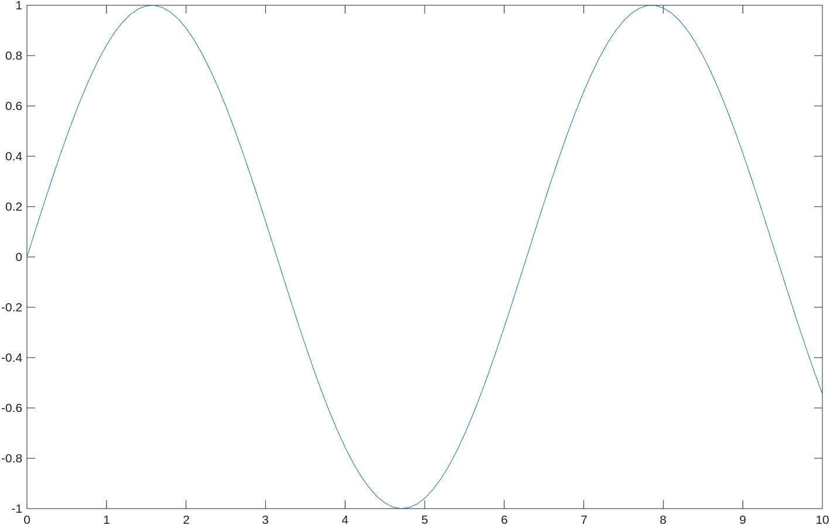
Vector: Arithmetics - vectorized function
Example:
Simulate the following signal in MATLAB:
, where .
Solution:
We can simulate a vector of finite time-stamp ’t’ as a row vector.
>> t = 0:0.1;10;
Since a function ’sin’ in MATLAB can take vector, we can pass the entire vector in without iterating over each individual element.
>> y = sin(t);
>> plot(t,y); % plot y vs t

Slide 20
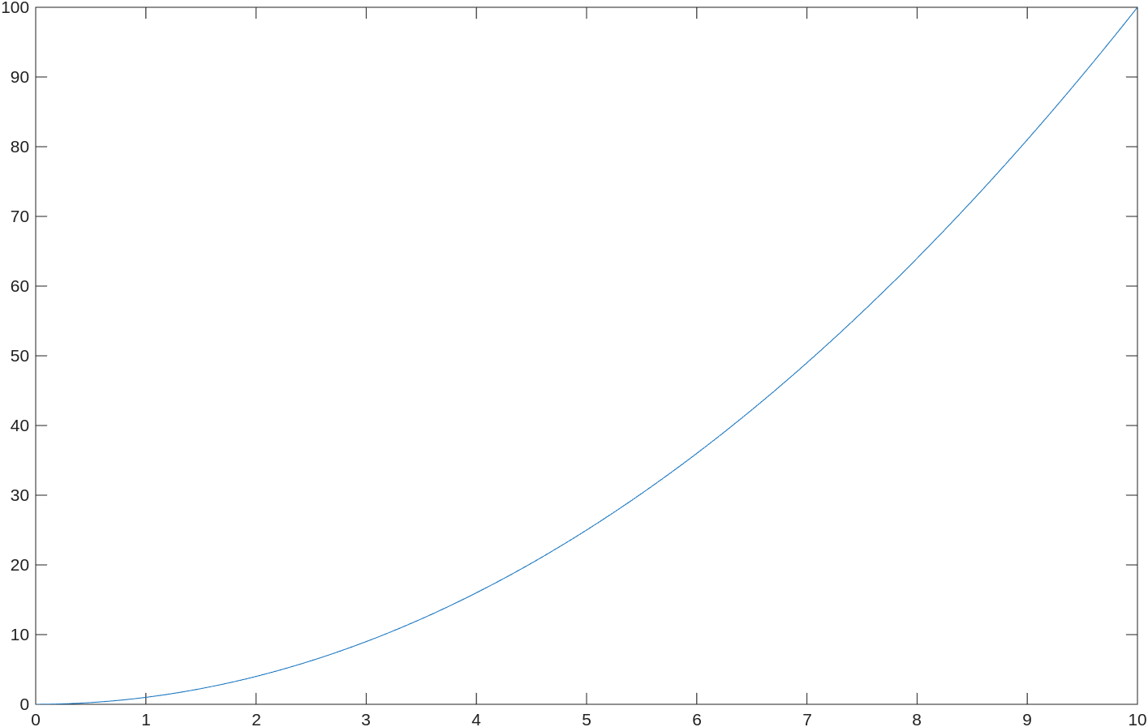
Vector: Arithmetics - element-wise operation
Example:
Simulate the following signal in MATLAB:
, where .
Solution:
Using ’^2’ directly on ’t’ will cause an error. This is because ’^2’ is seen as a matrix operation. In this case, we want to square each element of vector ’v’. Therefore, we should use element-wise operation. Add a period in front of these operation (’.^’,’.*’,’./’) will allow the operation to perform in element-wise fashion.
>> t = 0:0.1;10;
>> y = t.^2; % square each element
>> plot(t,y);

Slide 21

Matrix: Construction
Construct the following matrix:
Solution:
% Method 1: row-by-row
>> A = [1 2 3 4; 2 4 6 8; 3 6 9 12]
A =
1 2 3 4
2 4 6 8
3 6 9 12
% Method 2: column-by-column
>> A = [[1;2;3] [2;4;6] [3;6;9] [4;8;12]]
A =
1 2 3 4
2 4 6 8
3 6 9 12

Slide 22
Matrix: Construction with pre-defined functions
% 3-by-3 square zero matrix
>> B = zeros(3)
B =
0 0 0
0 0 0
0 0 0
% 3-by-5 zero matrix
>> B = zeros(3,5)
B =
0 0 0 0 0
0 0 0 0 0
0 0 0 0 0
% zero matrix same size as B
>> C = zeros(size(B))
C =
0 0 0 0 0
0 0 0 0 0
0 0 0 0 0
% 2-by-6 one matrix
>> D = ones(2,6)
D =
1 1 1 1 1 1
1 1 1 1 1 1
% 4-by-4 identity matrix
>> I = eye(4)
I =
1 0 0 0
0 1 0 0
0 0 1 0
0 0 0 1

Slide 23
Matrix: Accessing elements
% Access element in the third row and fourth column
>> A(3,4)
ans =
12
% Access all elements in first and third rows, and all columns
>> A([1 3],:)
ans =
1 2 3 4
3 6 9 12
% Access every elements in the first row except the last column
>> A(1,1:end-1)
ans =
1 2 3
% Access the 7th element (determined by reshaping the matrix into a vector column-wise)
>> A(7)
ans =
3

Slide 24


Matrix: Multiplication
Example: Based on the following matrices,
, compute .
Solution:
>> A = [1:1:4;2:2:8;3:3:12]; B = [1:4;5:8]'; C = [1;-1];
>> A*B*c
ans =
-40
-80
-120
Dimensions and order matter !!

Slide 25



Matrix: Solving system of equation
Example: Solve for x , y , and z.
Solution:
% straightforward but slow
>> inv([2 1 -1; 1 0 1; 0 2 2])*[1;2;1]
ans =
1.1250
-0.3750
0.8750
% faster using left-pseudoinverse
>> [2 1 -1; 1 0 1; 0 2 2]\[1;2;1]
ans =
1.1250
-0.3750
0.8750

Slide 26
Matrix: Other useful operation
% normalized eigenvectors and diagonal matrix of eigenvalues
>> [V,D] = eig(A)
% Singular value decomposition
>> [U,S,V] = svd(A)
% matrix power (i.e. square)
>> A.^2
% reshaping matrix to desired size (number element must match)
>> B = reshape(A,[3,4]) % repeating the given matrix: B = [A A A A; A A A A; A A A A]
>> B = repmat(A,[3,4])
% swap dimensions for tensor
>> B = permute(A,[1,3,2])

Slide 27
Helpful Function
% clear command window
>> clc
% clear entire workspace
>> clear
% clear variable A and B from workspace
>> clear A B
% save all variables from workspace to ‘filename.mat’
>> save(‘filename’)
% load all variables from ‘filename.mat’ to the current workspace
>> load(‘filename’)
% save only variables A and B from workspace to ‘filename.mat’
>> save(‘filename’,’A’, ‘B’)
% display “Help text” of ‘plot’ (replace ‘plot’ with any functions)
>> help plot
% open full documentation for ‘plot’
>> doc plot

Slide 28
Script
To create a new script, press Ctrl+N or select “New Script” in toolstrip under “Home” tab
t = (0:0.1:10)’;
y = sin(t);
plot(t,y)
To save the script, press Ctrl+S or “Save” in the toolstrip under “Editor” tab. (Standard naming convention for most programing language (i.e. myFirstScript.m)
To run the script:
Option 1: Press “Run” in the toolstrip
Option 2: Call the script name (without .m) in the command window.
>> myFirstScript

Slide 29
Filesystem
It’s your responsibility to manage and organize files. Make sure that MATLAB can see the file if you want to call it.
>> mkdir('test_folder') % create ‘test_folder’ in the working directory >> edit('test_folder/mySecondScript.m') % edit ‘mySecondScript.m’ in ‘test_folder’ directory
Enter the following code in the script and save.
>> mySecondScript % This throws an error because MATLAB cannot see ‘mySecondScript.m’
Unrecognized function or variable 'mySecondScript'.
>> addpath('test_folder') % add path to test_folder
>> mySecondScript % MATLAB can see ‘mySecondScript.m’ now
t = (0:0.1:10)’;
y = sin(t);
dy = cos(t);
plot(t,[y dy])

Slide 30
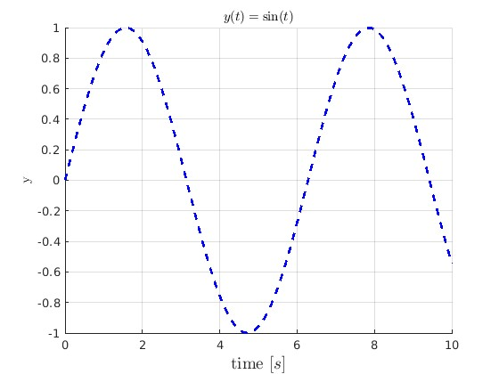
Visualization : Example 1 (Single Plot)
% Data
t = (0:0.1:10)';
y = sin(t);
hold('on'); % hold axis for multiple plots
% plot with dotted line and corresponding colors in 'c'
plot(t,y,'b--','LineWidth',2);
grid('on'); % add grid for readability
xticks(0:2:t(end)); % assign ticks on horizontal axis
xticklabels(0:2:t(end)); % assign tick labels on horizontal axis
% add label for horizontal axis
xlabel('time [$s$]','FontSize',14, 'Interpreter','latex')
% add label for vertical axis
ylabel('y','Interpreter','latex')
% add title to the plot
title('$y(t)=\sin(t)$','Interpreter','latex')

Slide 31
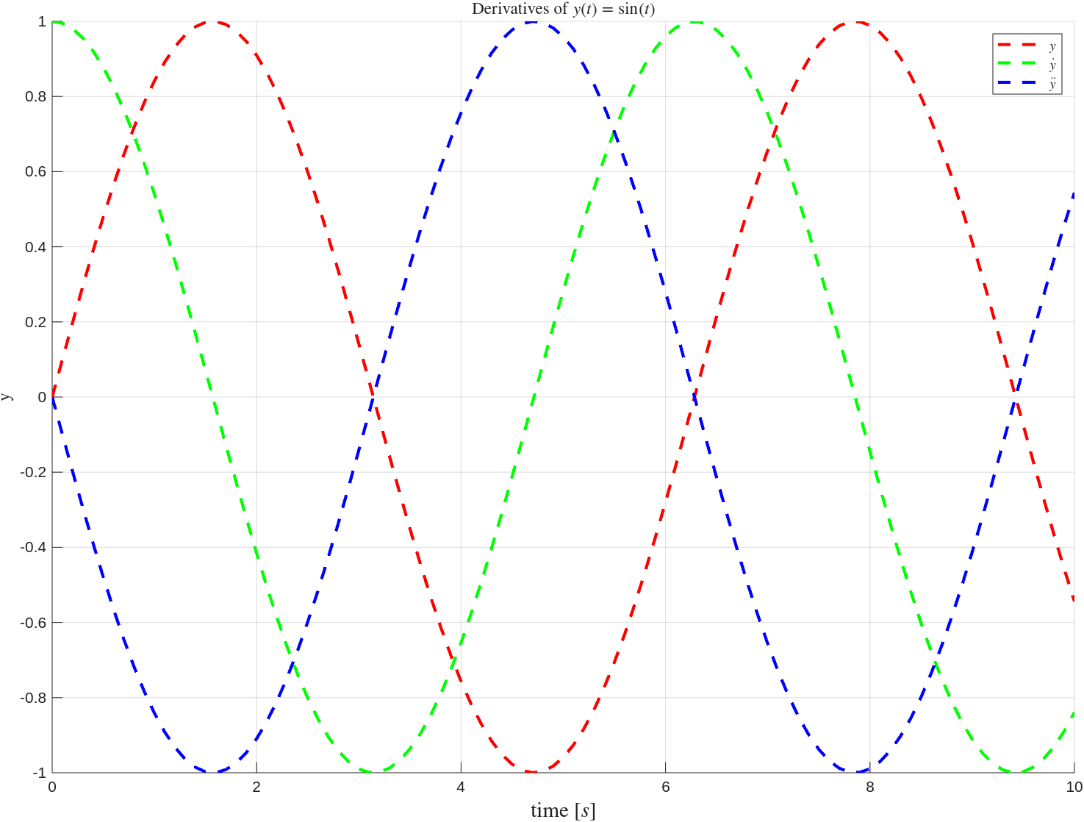
Visualization : Example 2 (Axis Manipulation)
% Data
t = (0:0.1:10)';
y = [sin(t) cos(t) -sin(t)];
ax = axes; % create axis for handling plot consistently
hold(ax,'on'); % hold axis for multiple plots
c = 'rgbmkyc'; % array of colors (char)
% loop over all channels in y
for i = 1:size(y,2)
% plot with dotted line and corresponding colors in 'c'
% Line's width is 2.
plot(ax,t,y(:,i),[c(i) '--'],'LineWidth',2);
end
grid(ax,'on'); % add grid for readability
xticks(ax,0:2:t(end)); % assign ticks on horizontal axis
xticklabels(ax,0:2:t(end)); % assign tick labels on horizontal axis
% add label for horizontal axis
xlabel(ax,'time [$s$]','FontSize',14, 'Interpreter','latex')
% add label for vertical axis
ylabel(ax,'y','Interpreter','latex')
% add legends to the plot using latex interpreter
legend('$$y$$','$$\dot{y}$$','$$\ddot{y}$$','interpreter','latex')
% add title to the plot
title('Derivatives of $y(t)=\sin(t)$','Interpreter','latex')

Slide 32
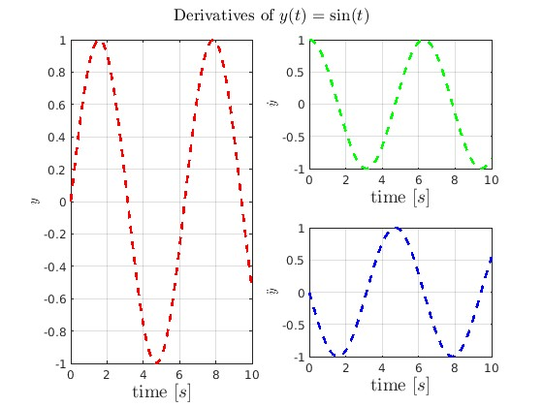
Visualization : Example 3 (Subplots)
% Data
t = (0:0.1:10)';
y = [sin(t) cos(t) -sin(t)];
ax_1 = subplot(2,2,[1 3]);
ax_2 = subplot(2,2,2);
ax_3 = subplot(2,2,4);
ax = [ax_1;ax_2;ax_3];
c = 'rgbmkyc'; % array of colors (char)
% cell array of strings
ylabels = {'$$y$$','$$\dot{y}$$','$$\ddot{y}$$'};
% loop over all channels in y
for i = 1:size(y,2)
% plot with dotted line and corresponding colors in 'c'
% Line's width is 2.
plot(ax(i),t,y(:,i),[c(i) '--'],'LineWidth',2);
grid(ax(i),'on');
xticks(ax(i),0:2:t(end));
xticklabels(ax(i),0:2:t(end));
xlabel(ax(i),'time [$s$]','FontSize',14, 'Interpreter','latex')
ylabel(ax(i),ylabels{i},'Interpreter','latex')
end
% add title to the figure
sgtitle('Derivatives of $y(t)=\sin(t)$','Interpreter','latex')

Slide 33
Visualization : Example 4 (Animation)
m = 1;
l = 1;
b = 1;
g = 9.80665;
t_max = 10;
x_0 = [pi/2;0];
[t,x] = ode45(@(t,x)[x(2);(g/l)*sin(x(1))-(b/(m*l^2))*x(2)],[0 t_max],x_0);
ax = axes;
hold(ax,'on')
axis(ax,'equal') % make sure that axis are in the same scale
axis(ax,[-1.5,1.5,-1.5,0.5])
% Static plot for ground
plot(ax,[-2 2],[0 0],'k','LineWidth',3)
% Initial plot to instantiate plot handle
theta = x(1,1);
h_pendulum = plot(ax,[0 l*sin(theta)],[0 l*cos(theta)],'b','LineWidth',3);
% Loop over the remaining time stamp
for i = 2:numel(t)
pause(t(i)-t(i-1));
theta = x(i,1);
% Instead of replotting, change the data.
h_pendulum.XData = [0 l*sin(theta)];
h_pendulum.YData = [0 l*cos(theta)];
end

Slide 34

SIMULINK

Slide 35
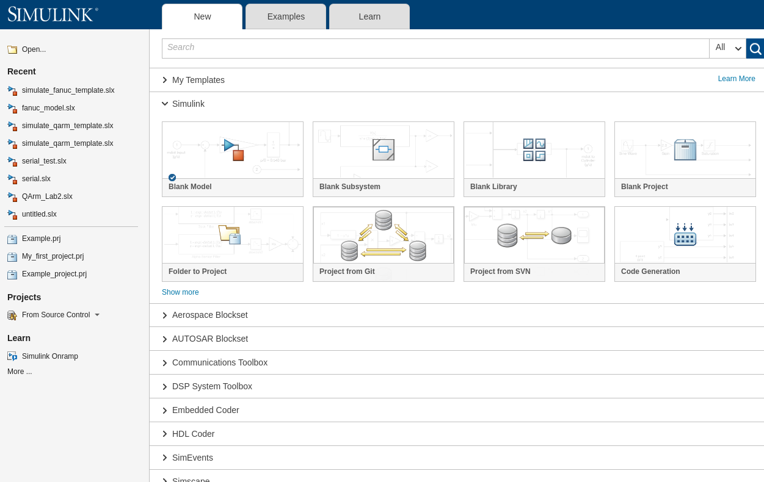
Simulink Start Page
Click this to create new blank model

Slide 36
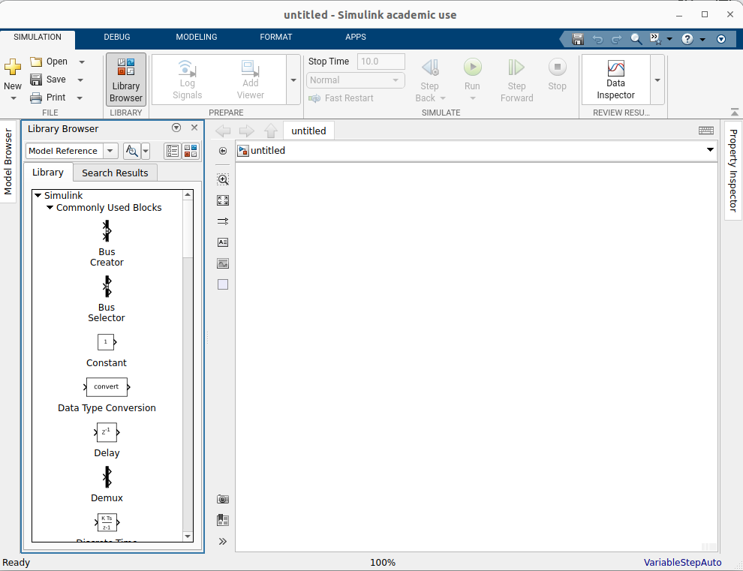
Simulink GUI
Current Model Layer
Library Browser
Canvas

Slide 37
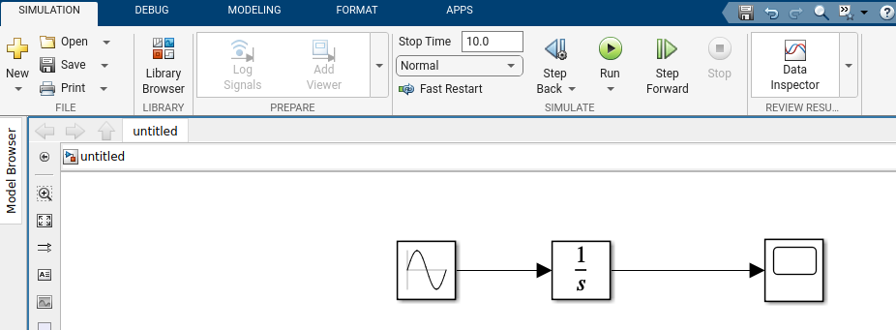
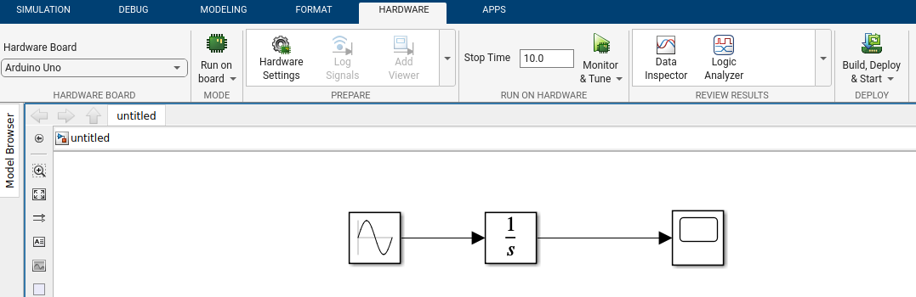
Basic Dynamics System Simulation with Simulink
Normal Simulation
Run the simulation as fast as possible
Good for debugging and “simulating” dynamics system
Real-time pacing
Slow down the pacing to system clock.
Good for testing real-time behavior
Real-time Targets
Build, Deplot, and Run code generated from Simulink to the selected real-time target hardware
Monitor & Tune allows us to monitor and change parameters while executing the code

Slide 38
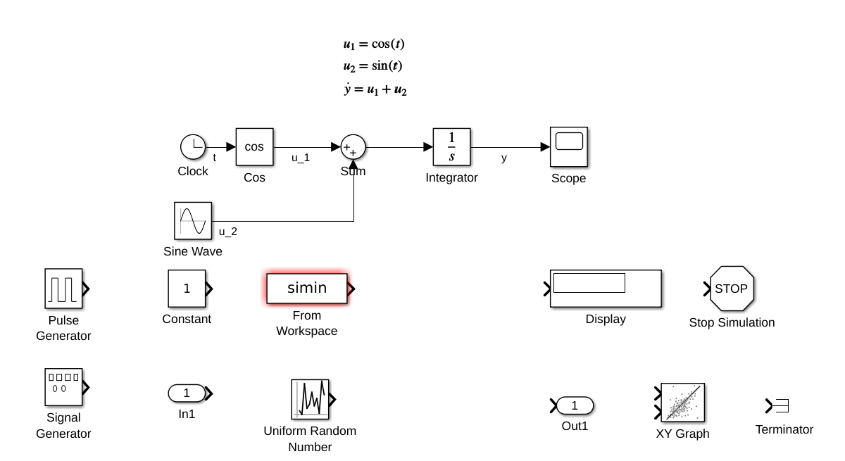
Signal Synthesis and Monitoring (Sink & Source)
Simulink Basic Library offers variety of methods to generate signals via ‘Sink’ blocks.
Users can monitor and visualize these signal using ‘Source’ blocks.

Slide 39
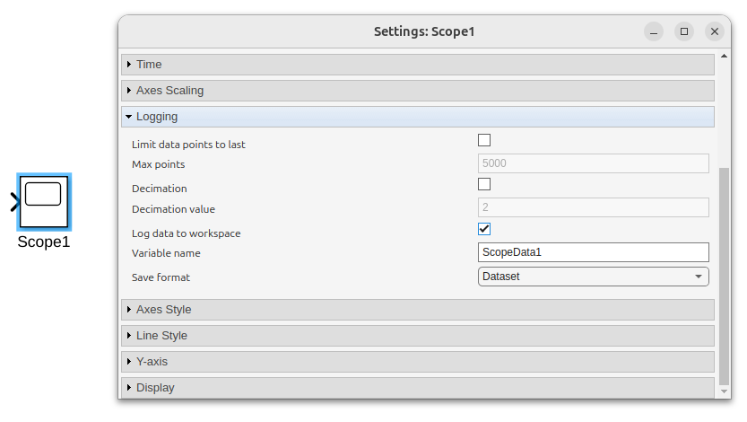
Commonly-used Blocks: Scope
A Scope block plots the input signal(s). It can also log the data and exports to MATLAB’s workspace.
Use Cases:
Monitoring
Debugging

Slide 40
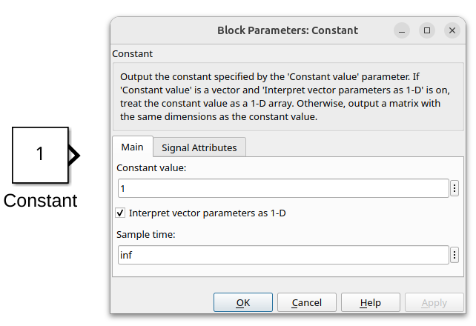
Commonly-used Blocks: Constant
A Constant block provides a constant value (scalr, vector, matrix).
Use Cases:
Constant Reference Signal
Constant but adjustable parameter

Slide 41
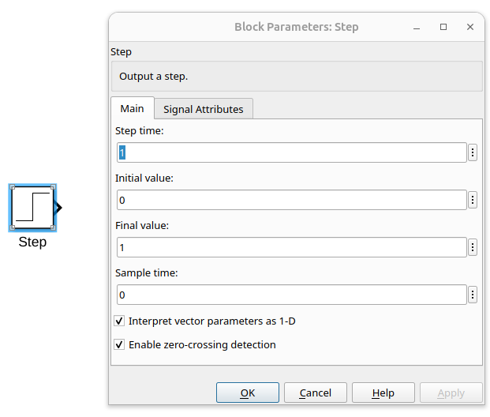
Commonly-used Blocks: Step
A Step block acts like a step function .
Use Cases:
A sudden change in reference signal
Modelling Trigger’s behavior
Step Input for testing steady-state error

Slide 42
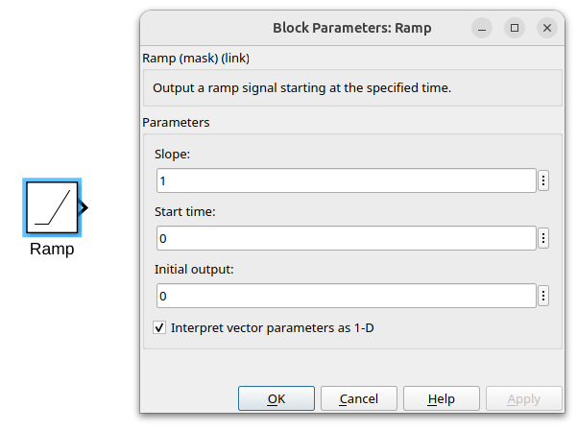
Commonly-used Blocks: Ramp
A Ramp block outputs a ramp (linear) signal starting at the specified time.
Use Cases:
Modelling behavior with constant speed
Ramp input for testing steady-state error

Slide 43
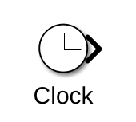
Commonly-used Blocks: Clock
A clock provides timestamp since the beginning of the simulation
Use Cases:
Need for time-varying signal & system

Slide 44
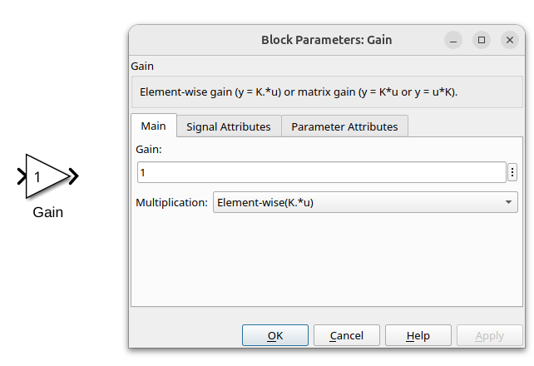
Commonly-used Blocks: Gain
A Gain block multiplies the input by a constant (scalar, or matrix) .
Use Cases:
Control gain
Typical gain for modelling

Slide 45
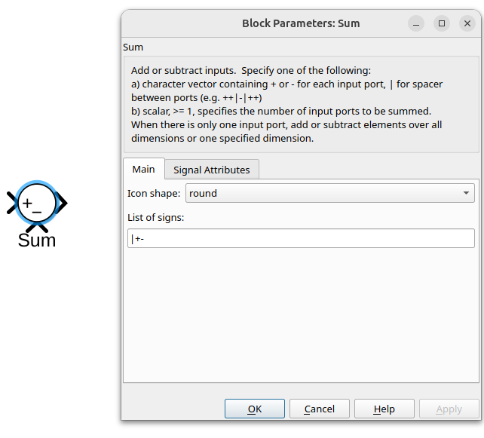
Commonly-used Blocks: Sum
A Sum block adds or subtracts input signals and returns the sum of those signals.
Use Cases:
Calculating Errors
Adding noise, disturbance
Superimposing control laws

Slide 46
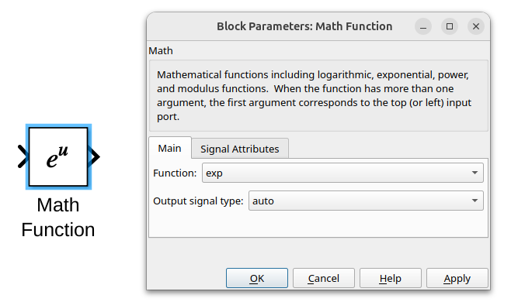
Commonly-used Blocks: Math Function
A Math Function block provides some basic rational and transcendental functions like exponential, logarithm, power, square root, excluding trigonometric functions.
Use Cases:
Mathematics model

Slide 47
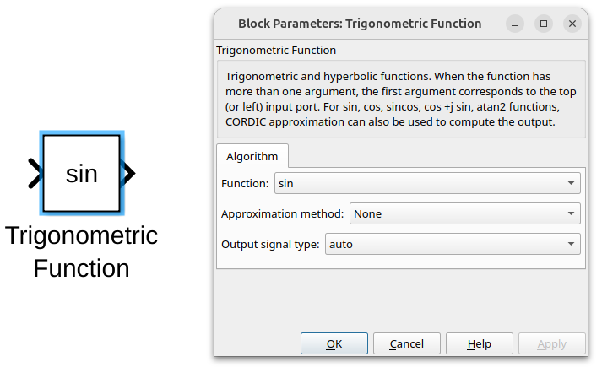
Commonly-used Blocks: Trigonometric Function
A Trigonometric function block provides standard trigonometric functions including sine, cosine, tangent, inverse trig., hyperbolic trig., etc.
Use Cases:
Mathematics model

Slide 48
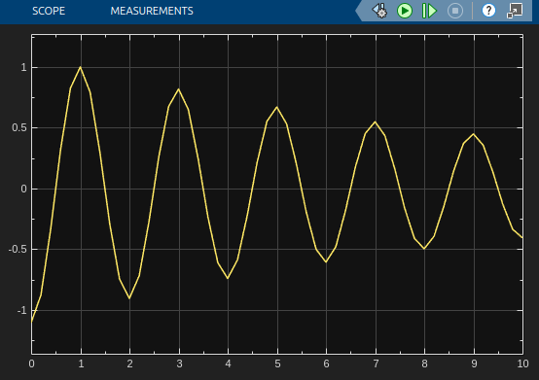
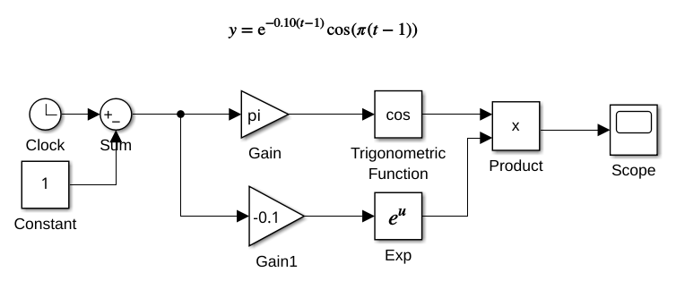
Example

Slide 49
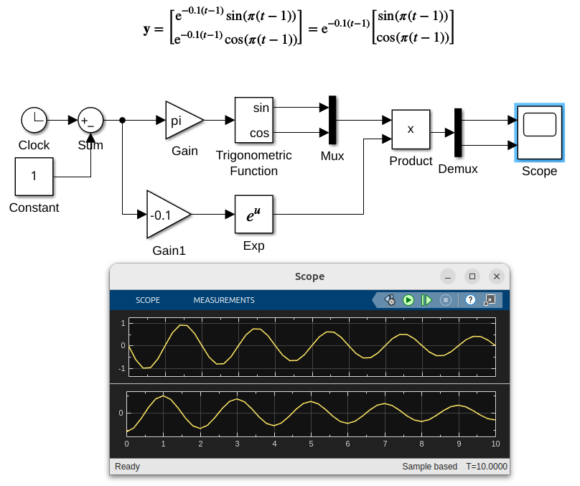
Multi-channel Signals: Mux & Demux
A Mux block forms a multi-channel signal based on give inputs.
A Demux block splits multi-channel signal into multiple single-channel signal.

Slide 50
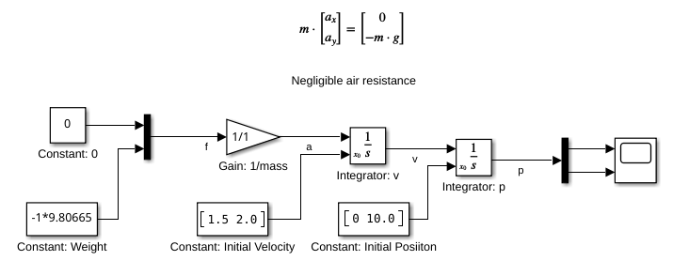
Time Integration: Integrator
An Integrator block perform integration with respect to time based on specified initial condition of the state, which can be scalr, vector, or matrix.
Use cases:
Simulating solution of differential equations
Integral term in PID Control

Slide 51
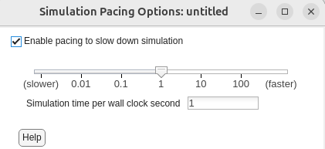
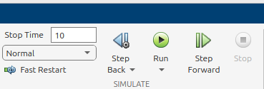
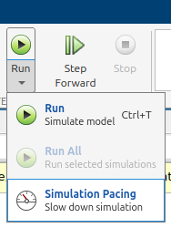
Simulation Time: Pacing
By default, Simulink will run the model normally as fast as it possibly can to simulate the dynamics system.
Its pacing can be adjusted by selecting ‘Simulation Pacing’. This will slow down the computation

Slide 52
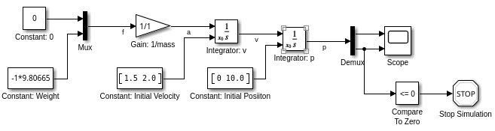
Simulation Time: Conditional Stop
Simulation does not have to last till the specified duration. It can be stopped using Stop Simulation block.
When trigger by non-zero value, a Stop Simulation block stop the entire simulation. This can help automate experimentation.
In this example, the simulation stops when the vertical position is less than or equal to zero. In other words, the simulation stops when the particle hits the ground.

Slide 53
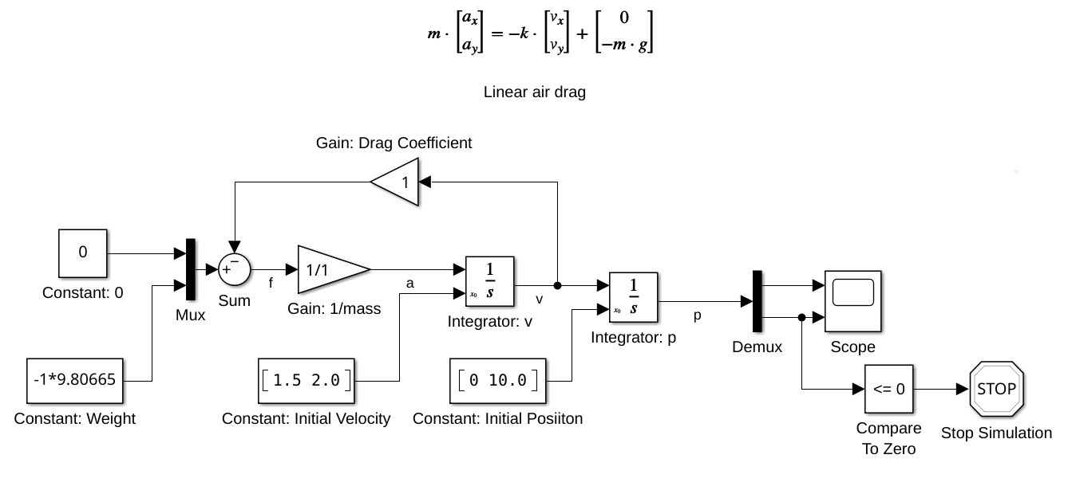
System with Feedback Loop
A dynamics system may have a feedback loop, whose behavior depends on its internal states.

Slide 54
Exporting Data to Workspace: Scope
When using normal simulation, a Scope block can be configured to log the input signal(s) and save them as a variable in workspace. The format can be ‘Array’, ‘Structure’, ‘Dataset’.
When using real-time target hardware, the format should be set to ‘Array’.

Slide 55
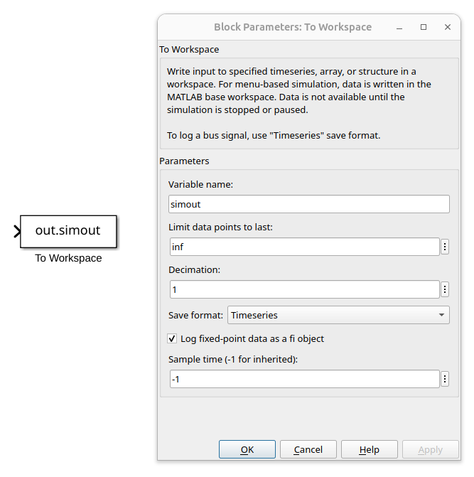
Exporting Data to Workspace: To Workspace
Alternatively, a To Workspace block can be use to export the input signal(s) directly to the specified variable. The format includes ‘Array’, ‘Structure’, and “TimeSeries’.
When using with real-time Target hardware, the format must be set to ‘Array’.

Slide 56
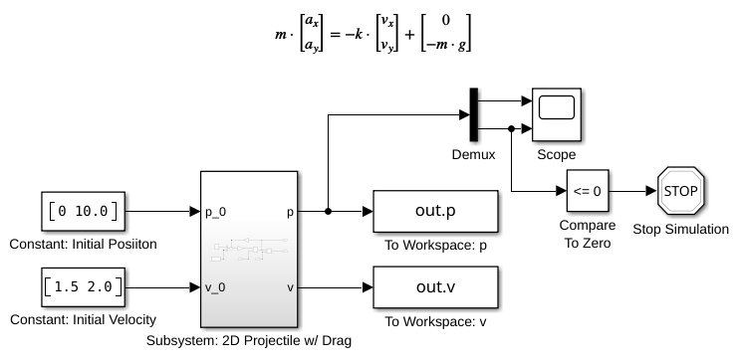
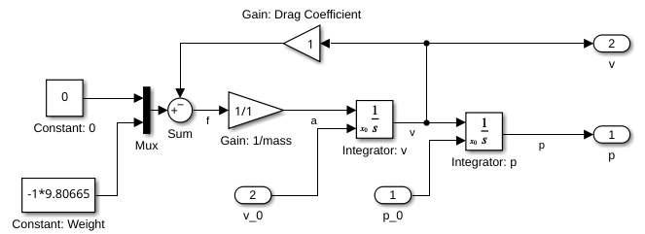
Subsystem
A collection of selected blocks can be grouped together and form a ‘subsystem’.
Drag and select the desired group of blocks and press ‘Ctrl+G’ to form a group.
Additional inputs and outputs can be added by using ‘In1’ and ‘Out1’ blocks.

Slide 57
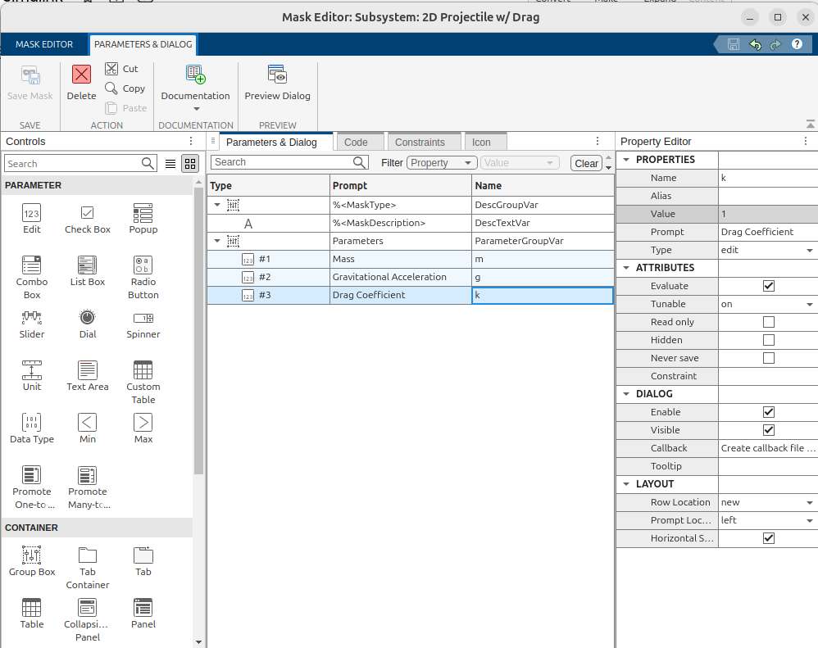
Masking Subsystem
Organize and parameterize a subsystem by adding a mask to a subsystem
Select a subsystem and press ‘Ctrl+M’ or right-click then select ‘ Mask’ > ’Create Mask’
User can add UIs and link them to any written parameters inside the subsystem.
Initial value when not assigned
Name of the variable in the model
You can add different types of UIs

Slide 58
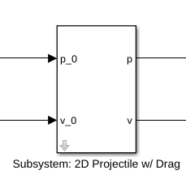
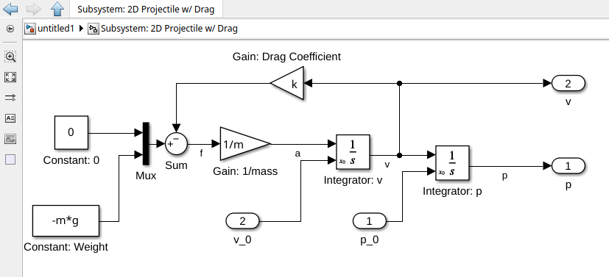
Linking to a Masked Subsystem
Current Layer
Once the mask is created, the subsystem can be accessed by clicking on the bottom-left corner of the subsystem.
The upper-left corner of the canvas indicates the layer of the system.
Associate the subsystem with the names of defined parameters accordingly.
Once they are defined,
Parameters: m, g, and k
Click here to define the model subsystem

Slide 59
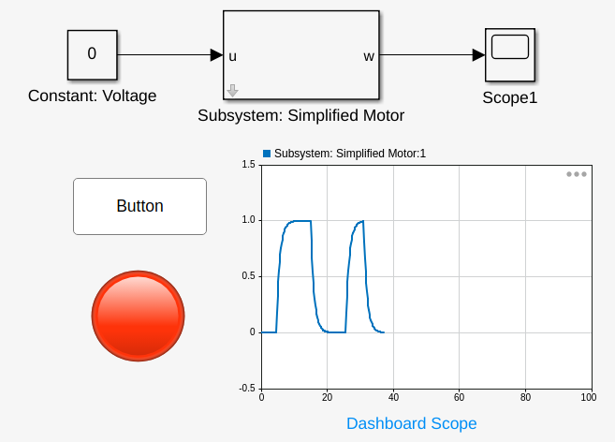
Linking GUI with Model
Input Interface blocks such as button, knob, slider switch, toggle switch, or slider, can be linked to a constant block. To interact with the simulated model, real-time pacing or real-time target hardware should be used.
The output interfaces include Dashboard scope, lamp, and gauges.
GUIs can be useful for Human-In-the-Loop experiments, i.e. waiting until the system is stable, the toggle the disturbance.

Slide 60
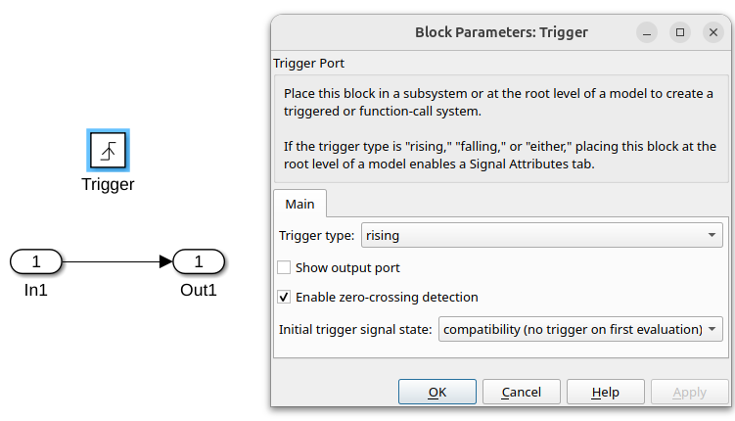
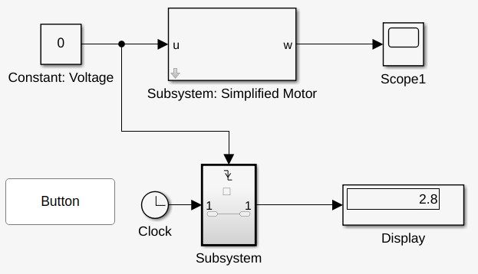
Trigger & Triggered Subsystem
Example:
Obtain the time stamp when the button is released.
Solution:
We can use the change in the input signal to “trigger” another subsystem that reads “time” from a clock. The trigger should be configured to ‘falling edge’ for this example.
A Trigger block, when placed inside a subsystem, turns the subsystem into a triggered subsystem, which executes when triggered (rising edge, falling edge ,both).

Slide 61
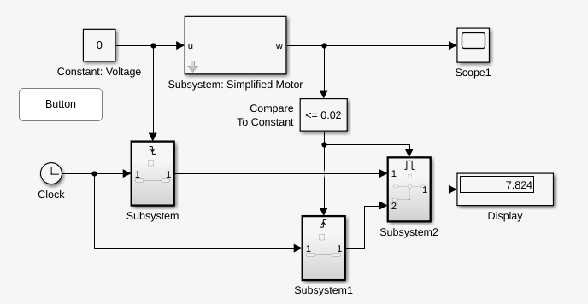
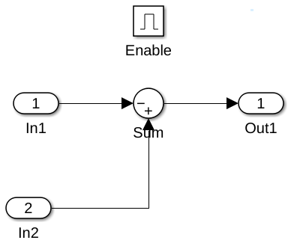
Enable & Enabled Subsystem
An Enable block, when placed inside a subsystem, turns the subsystem into an enabled subsystem, which executes when enabling signal is true.
Example:
The user can start this experiment by holding down the button until the output velocity ‘w’ reaches a steady state (w=1).
After reaching the steady-state, the user can release the button. The system will determine the time it takes for the system to go from 1 to 0.02 (98% of the value). This is known as settling time of 1st order system. The time difference is only computed when the value is less than 0.02.

Slide 62
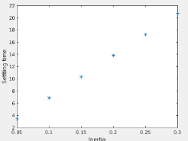
Automating experiments with MATLAB & Simulink
A saved simulink model can be called from MATLAB using:
>> sim(’filename.slx’)
We can iterate over a list of parameters to automate experiments.
Example:
J_v = [0.05 0.1 0.15 0.2 0.25 0.3];
T = zeros(1,numel(J_v));
for i = 1:numel(J_v)
J = J_v(i);
out = sim('exp_01.slx');
T(i) = out.simout.Data(end);
End
plot(Jv,T,'*');
xlabel('Inertia');
ylabel('Setlling Time');

Slide 63
Now you know the basics !!!

